Slide 1
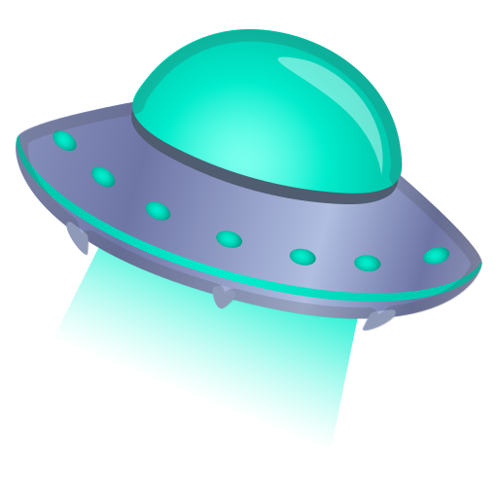
Can you survive for 10 seconds?

Slide 2
Main goal
Implement functions and methods that were learned in class
Increase knowledge
Be more creative

Slide 3
Game goal
Move the navy between the meteors more fast you can in 10 seconds.
Nice game for drink with your friends. Especially when you are drunk.

Slide 4
Challenges
Decided the game.
What the game to do.
Implement the functions
Find the problems inside the functions
Understand that memory is very important

